Slide 1
RCB - IPL Strategy
AYUSHI SINGH 17/04/2025

Slide 2
Description:
You are hired as a sports data analyst by RCB, where the team is looking for top-performing and reliable players to win tournaments, considering both on-field performance and value for money in the mega player auction of 2017.

Slide 3
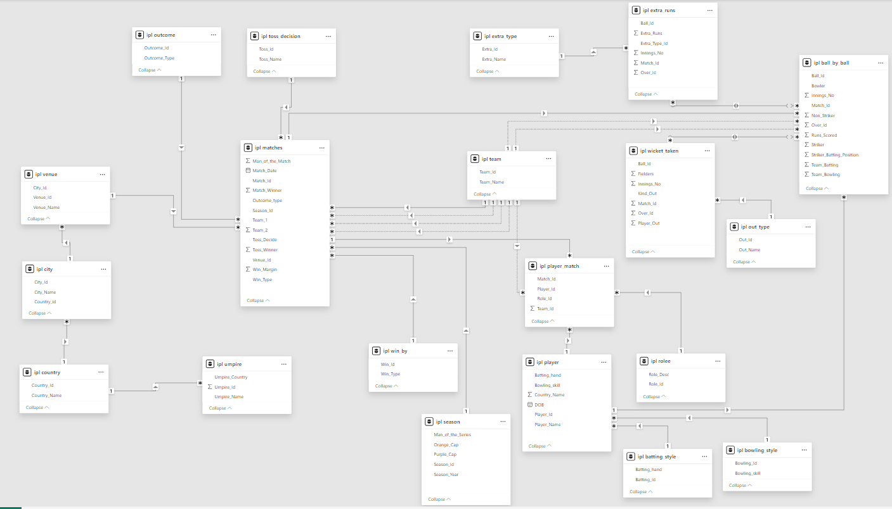
Database Schema:

Slide 4
Objective:
Identify best-performing players based on key metrics
Optimize player selection and auction investments
Strengthen overall team composition for the 2017 season

Slide 5
Evaluate Last Year’s Team Performance:
Analyze team stats: runs scored, wickets taken, matches won/lost
Identify strengths and gaps
Understand performance trends

Slide 6
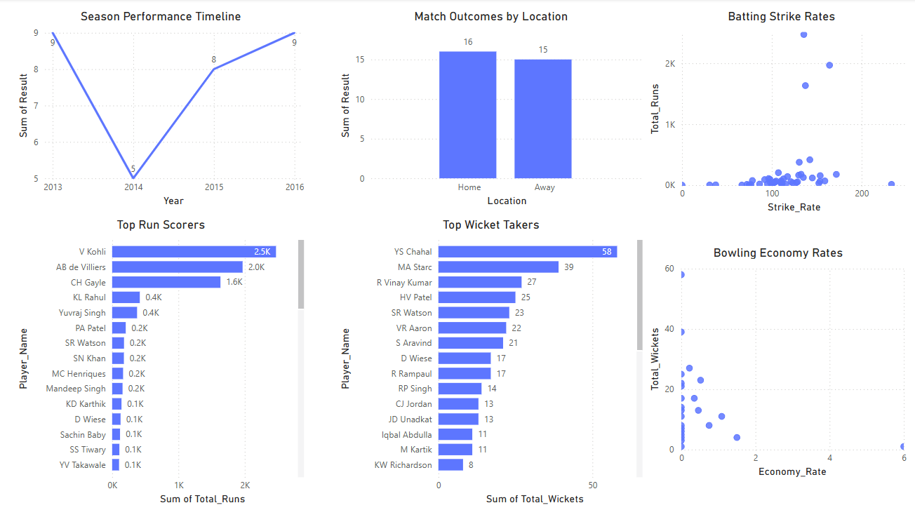
Evaluate Last Year’s Team Performance:

Slide 7
Key Strategy Highlights
Analyze performance metrics (batting avg, strike rate, economy, etc.)
Prioritize death-over bowlers
Include a reliable all-rounder
Focus on players who perform well against RCB

Slide 8
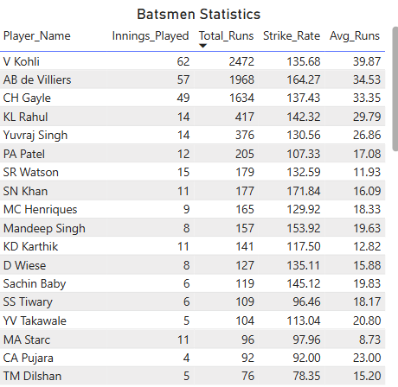
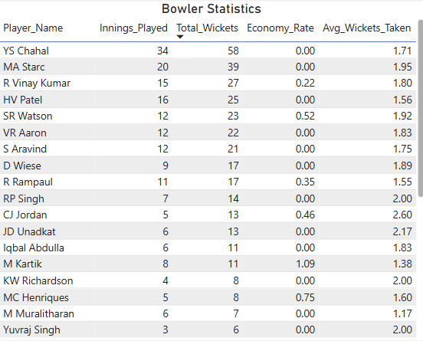
Key Strategy Highlights

Slide 9
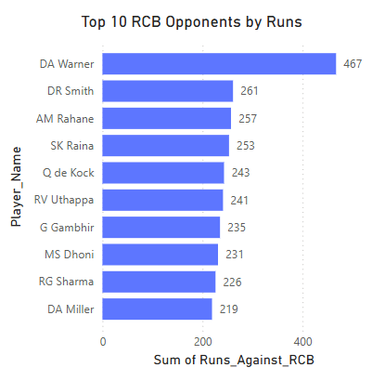
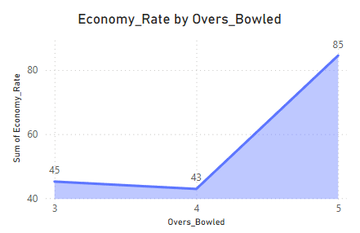
Key Strategy Highlights

Slide 10
Additional Strategic Focus Areas:
Retain consistent, impactful players
Avoid expensive but underperforming options
Strengthen middle-order batsmen and finishers
Look for powerplay specialist bowlers

Slide 11
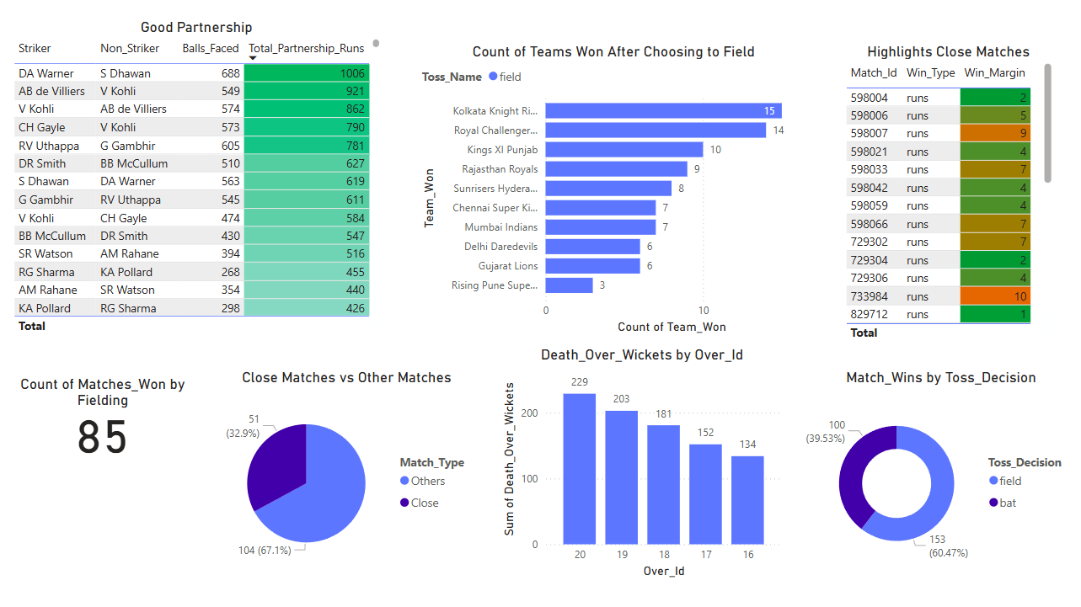
IPL Match Insights Report:

Slide 12
Summary & Next Steps:
Combine data-driven insights with expert judgment
Build a balanced and value-driven squad
Prepare for dynamic auction strategy

Slide 13


